Slide 1

Airline safety
Nekeitrius Davis

Slide 2
AGENDA
Airline Fatalities by Year​
Vehicle Deaths by Year
​Death Risk Comparisons
Summary
​References​

Slide 3
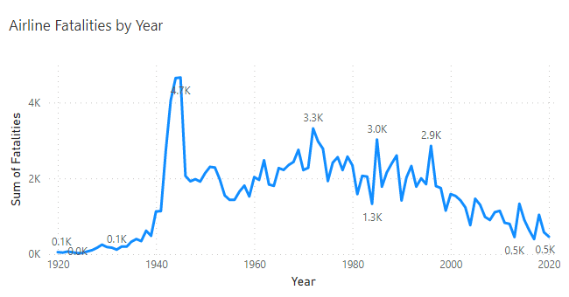
Airline Fatalities by Year
Notes:
he graph I used here was a line chart because it can show trends of data over time. This particular graph shows the sum of airline fatalities from 1920 to 2020. I found that generally looking there has been a decrease in the amount of fatalities over the years. There was a significant peak in 1945 that was 1.4k more than the new highest peak. I would have to consider what type of things occurred that year for there to be soo many crashes. Also I know that the decrease in recent years would mainly be because of covid and the abrupt stop of air travel in 2020.

Slide 4
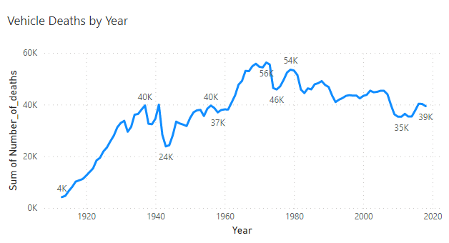
Vehicle deaths by Year
Notes:
The graph I used here was a line chart because it can show trends of data over time. This particular graph shows the sum of airline fatalities from 2000 to 2020. This is the same graph as the above graph I did but it is more focus on the years of 2000-2020 since that is a 20 year time frame and I can see some highs and lows more clearly.

Slide 5
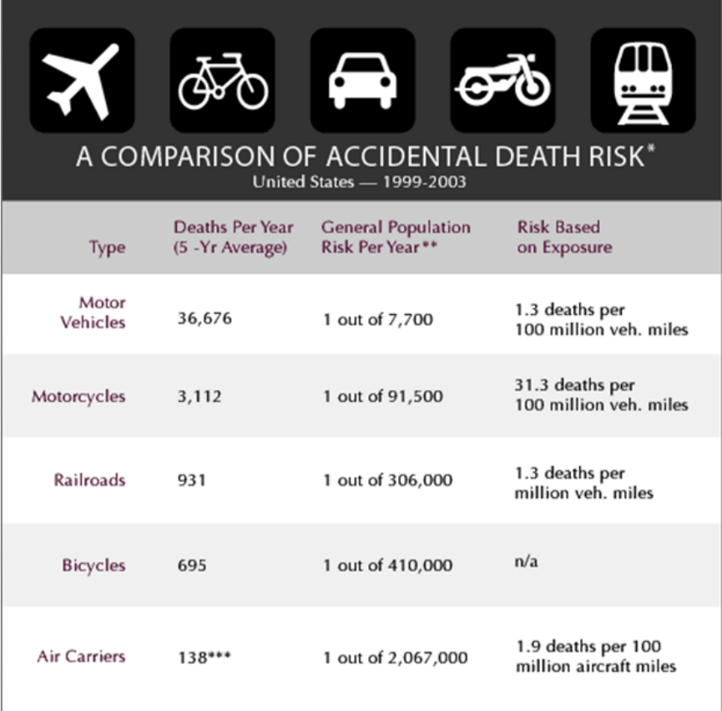
Death Risk Comparisons

Slide 6
Summary

Slide 7
Ropeik, D. (2006, September 1). How risky is flying? . PBS. Retrieved April 27, 2023, from https://www.pbs.org/wgbh/nova/planecrash/risk-01.html
Chambers, M. (2013, March 7). Transportation safety by the numbers. Bureau of Transportation Statistics. Retrieved April 27, 2023,from https://www.bts.gov/archive/publications/by_the_numbers/transp ortation_safety/index
Silver, N. (2014, July 19). Should travelers avoid flying airlines that have had crashes in the past? FiveThirtyEight. Retrieved April 27, 2023, from https://fivethirtyeight.com/features/should-travelers-avoidflying-airlines-that-have-had-crashes-in-the-past/
Fatality Analysis Reporting System (FARS). NHTSA. (n.d.). Retrieved April 27, 2023, from https://www.nhtsa.gov/researchdata/fatality-analysis-reporting-system-fars Sour

